Slide 1

Assignment 3: The critical discussion of three articles taken from The Journal of Computer Assisted Learning Volume 23 Issue 4 (special issue) [2007]
The Purple Group
Eliana Mitsinga
Ali Mohammed Alraai
Ian Boothe
Robin Winslow Morris (coordinator)

Slide 2
What happened?
Eliana, Ali and Ian each chose an article from the special issue of JCAL.
They were then each assigned to one of the other groups, and they led an online discussion with that group over four days.
In this presentation, they will each, in turn, present and discuss the points raised from their respective discussions.

Slide 3
What are these papers about?
“
The papers in this special issue address different aspects of the transformation of education for a mobile society.
”
M. Sharples [editorial, 2005]

Slide 4


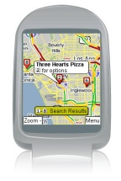
A little background...
“
The papers in this special issue address different aspects of the transformation of education for a mobile society.
”
M. Sharples [editorial, 2005]
Points taken from Dr Sharples’ introduction to the JCAL special issue:
Historically, education has evolved extremely slowly Classroom-based formal learning, isolated from the world it is supposed to apply to – hardly changed since the 19th century.
But recently there is a strong movement for informal learning and community education. E.g.: wikipedia.org, wikimapia.org, wea.org.uk, infed.org
The next step is to provide education in mobile situations, for both formal and informal learning Google maps is now available on mobile phones

Slide 5
A little background (2)...
“
The papers in this special issue address different aspects of the transformation of education for a mobile society.
”
M. Sharples [editorial, 2005]
Points, continued:
Dr. Sharples asks whether the next decade could see a revolution similar to that in the entertainment industry.
To do this, education will have to face several issues: Problems similar to transformation in the entertainment business:
Maintaining quality
Maintaining copywrite
And new issues:
Assessing mobile learning
Bridging the gap between formal and informal education
The papers in this issue therefore address different aspects of how this transformation of education can be achieved

Slide 6
The articles themselves
“
Affordances of mobile technologies for experiential learning: the interplay of technology and pedagogical practices
”
Lai, Yang, Chen, Ho, Chan [2007]
Eliana Mitsinga led a discussion with the Blue group
“
Do handheld devices facilitate face-to-face collaboration? Handheld devices with large shared display groupware to facilitate group interactions
”
Liu & Kao [2007]
Ali Mohammed Alraai led a discussion with the Yellow group
“
Innovative socio-technical environments in support of distributed intelligence and lifelong learning
”
Fischer & Konomi [2007]
Ian Boothe led a discussion with the Green group

Slide 7
Over to you, Eliana....
“
Affordances of mobile technologies for experiential learning: the interplay of technology and pedagogical practices
”
Lai, Yang, Chen, Ho, Chan [2007]

Slide 8
Affordances of mobile technologies for experiential learning: the interplay of technology and pedagogical practices
Journal of Computer Assisted Learning
Volume 23
2007
Issue: 4 (special issue on mobile learning)
Pages: 326-337

Slide 9
Introduction
‘Personal digital assistants (PDAs) together with attendant embedded functionality are incorporated into an outdoor learning ﬂow activity in order to examine in what ways and to what extent experiential learning of elementary school students can be facilitated’. (Lai et al., 2007)

Slide 10
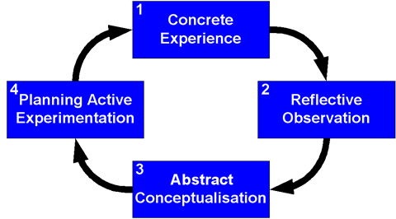
Experiential Learning
Kolb 1984: four-stage cycle
http://www.learningandteaching.info/learning/experience.htm

Slide 11
Experiential Learning
Weaknesses of experiential learning:
‘it lacks a mechanism for focusing awareness in the learning context’ (Miettinen, 2000)
‘students pay insufficient attention to abstracting from experience’ (Vince, 1998)
Aim: to eliminate weaknesses by utilizing mobile technologies and to investigate the affordances of such technologies in experiential learning.

Slide 12
Educational Affordances of Mobile Technologies
‘…the relationships between the properties of an educational intervention and the characteristics of the learner that enable particular kinds of learning by him or her’ (Kirschner, 2002)
Mobile technologies ‘afford’ real-time information whenever and wherever learners need it
Mobile technologies ‘afford’ a rapid access interface for note taking, such as photo taking, sound and video recording

Slide 13
In this study…
A mobile technology embedded learning ﬂow was developed to support ﬁeld-trip learning based on the experiential learning procedures in the following six stages:
Photo taking
Sensory experience
Further observation
Comparison
Question proposing
Final report

Slide 14
Method
Hypothesis: Mobile technologies can increase the level of knowledge creation through experiential learning beyond that which is achieved with traditional methods (paper and pencil).
Participants: 34 students, 16 boys and 18 girls, in one class using personal PDAs with plug-in cameras, and 32 students, 16 boys and 16 girls, in another class using paper and pencil.
Procedure:
Pre-test
Main activity
Post-test
Questionnaire
90-min course on the use of the PDAs
One-tailed t-tests

Slide 15
Procedure
Stage One: Photo taking
Stages 2, 3 and 4: Notes on PDAs
Stage 5: Record spoken questions
Stage 6: Final Report
(refer to photographs,
spoken questions, notes
on PDAs)
Stage One: Draw Pictures
Stages 2, 3 and 4: Notes on paper
Stage 5: Write questions
Stage 6: Final Report
(refer to sketches, written
questions and notes on
paper)

Slide 16
Results
Knowledge Gains:
The group with PDA retained and created more knowledge than the group without PDAs
Mobile Technology:
Photo taking and sound recording interfaces impressed the students
Students agree strongly that the taking of photos made learning more efficient
Students preferred taking photographs to drawing pictures
Sound recording was easy and quick compared with writing by hand

Slide 17
Results
Support System:
Students with PDA scored significantly higher than the group without PDA in most items
Students with PDA were more motivated than were students without PDA
Note-taking approach of the PDA saved time
Students with PDA were no better supported than students without PDA in handling trap-setting statements or figuring out questions

Slide 18
Learning flow
When the photo-taking stage was followed by the sensory experience stage, none of the students with PDA showed any interest in the second stage
Students with PDA found question proposing to be their most frustrating stage
Students without PDA for whom the sketching stage came first, found the sensory experience stage to be quite interesting
42.9% of students without PDA felt frustrated at the ‘sketching stage’

Slide 19
Discussion
It was not the technology itself but the interplay between technology and pedagogical practice that affords possibilities for better experiential learning
Students with mobile technology:
increased level of new knowledge creation
enhanced awareness of learning in context
enriched conceptualisation of knowledge through experience

Slide 20
The article discusses the technological support for experiential learning. Why the authors choose this kind of learning? Can you describe some possible reasons?
‘…this kind of learning is more beneficial’
‘The children are able to construct their own knowledge… While acting, they learn!’
‘The children in the report worked at their own pace and decided what information they should collect’
‘…a wonderful way to demonstrate the potential value of mobile learning’

Slide 21
Why Experiential Learning?
children are involved in their own learning actively and directly
appropriate and relevant to student’s real world
a method that provides obvious outcomes

Slide 22
Do you find any part of the article appealing? What makes it appealing? Support your opinion. If you believe that there isn’t something appealing or convincing explain why.
Two opinions:
‘Learning has to be interesting and I think the children in the study did find it interesting, I am talking about the topic as well as using the PDA's’
‘…on a qualitative level it was a very convincing description of a learning experience’
‘The material about the extra "knowledge created" by PDA learners was convincing’
‘…I would have liked to have seen more detail’
2 tailed t-test & specific t values and p values for the two comparisons
‘Perhaps all students should have been trained in PDA use

Slide 23
Which part of the article is appealing?
Students engaged in a variety of activities (e.g. took photographs, recorded sounds, developed questions, received feedback etc.)
Technology expands the range of choices that children have in school and attracts their interest

Slide 24
Do you think that the authors used the appropriate method for their experiment? You can support your answer with evidence from the article.
Two opinions:
‘Their experiment was reliable and valid’
‘The experiment consisted of several sections: pre-test, main activity, post-test and questionnaire’
‘Maybe they should have used more than one lesson’
‘…maybe the “students’ interests” factor influenced the results’
‘I'd have liked to have seen a more rigorous experimental design and statistical analysis’

Slide 25
Methodology
Well structured and good organised
The method is described in a way someone can replicate it
The procedure is specific and it contains different stages
The method is relevant with the hypothesis
Variety in the sections of the experiment
If there were more examples and tables it would be helpful

Slide 26
In what extend do the results have impact for the future of mobile learning in both the theoretical and the practical level?
‘…the study gave a good demo of the potential for gaining huge benefits from mobile learning for this specific type of learning’
‘…mobile learning can be more developed in the future in order to include and other kinds of learning (not only experiential learning)’
‘…new learning experiences or environments that can be developed for a broad range of both informal and formal learning contexts’
‘…the use of mobile technology can be used to attract attention at appropriate points in the learning task’
‘Mobile technologies will offer one more strategy with a wide range of activities’
But..
‘…further researches must be done in order to indicate more significant results which can strongly prove that mobile devices can improve learning’

Slide 27
Contribution…
Contribution to the theory:
The results of the study added more evidence to support the contribution of mobile technologies in the learning process.
Contains ideas for further researches
Contribution to the practice:
Practices not only for the technology sector but also for the pedagogical sector
Elements that can improve the method which was used

Slide 28
Over to you, Ali....
“
Do handheld devices facilitate face-to-face collaboration? Handheld devices with large shared display groupware to facilitate group interactions
”
Liu & Kao [2007]

Slide 29
Do handheld devices facilitate face-to-face collaboration? Handheld devices with large shared display groupware to facilitate group interactions C.-C. Liu & L.-C. Kao
Journal of Computer Assisted Learning
Volume 23 Issue 4, Pages 285 - 299
Published Online: 22 May 2007

Slide 30
Summary of the Paper
The development of handheld devices and wireless network has made possible new approaches to individual work and learning.
The purpose of this research study is to:
Explore whether handheld devices, wireless network and shared displays in classrooms sufficiently facilitate face-to-face collaboration
Explore whether the display equipment in classrooms fitted with shared display groupware can augment handheld devices in promoting communication
Methodology
8 weeks experiment
13 graduates
3 groups
3 learning environments

Slide 31
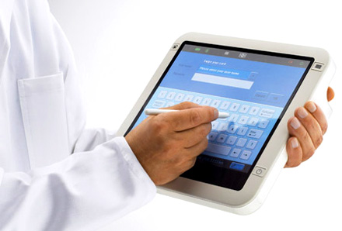
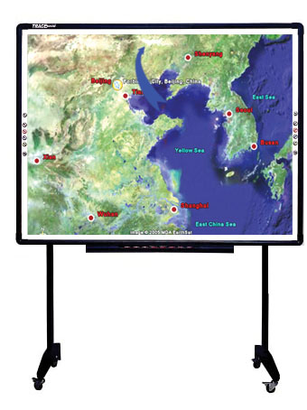
Activities with Tablet-PC only
Network-file-sharing
Sharing displays

Slide 32
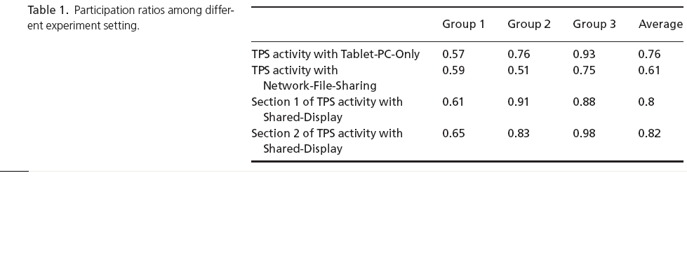

Slide 33
The findings of the experiment confirm that the shared display groupware promote increased group collaboration

Slide 34
Overall Findings
Findings relating to the study as a whole
Students with only handheld devices
× did not demonstrate human interaction and face-to-face collaboration.
√ ‘’personal working space’ for students to prepare group work
Display Screen
√ encourages and enables group members to participate in shared activities which lead to effective communication.
√ encourage student groups to cooperate and work on complex tasks.
The groupware
√ promotes a shared a group work space and peer reviewing.

Slide 35
Discussion group
Whether the design of handheld devices encourage student to collaborate during their learning?
Which possible techniques can improve students communication by using handheld devices?
Could using shared display increase students communication?

Slide 36
Discussion group
“there is way to know what the other kids are doing using wireless access or a large share screen”
“technology should create a space that every child has the opportunity to give his/her opinion and their opinion would be considered”
“It is through the talk that learning occurs." “Handheld devices restricts *talking among themselves*”
“technology is a tool rather than goal. We use technology to facilitate and enhance teaching and learning”

Slide 37
Over to you, Ian....
“
Innovative socio-technical environments in support of distributed intelligence and lifelong learning
”
Fischer & Konomi [2007]

Slide 38
Innovative socio-technical environments in support of distributed intelligence and lifelong learning Fischer, G. and Konomi, S. Journal of Computer Assisted Learning, 2007, Vol 23, Issue 4, pp338-50
A critical discussion

Slide 39
Summary of Article
WMT (Wireless and Mobile Technologies) provide opportunities to create socio-technical environments that empower humans
Lifelong learning perspective
Distributed intelligence
‘Intelligence augmentation’
‘Exploiting the power of social creativity’
‘Universe of one’
‘Co-evolution of new media and new theories about working, learning and collaborating’

Slide 40
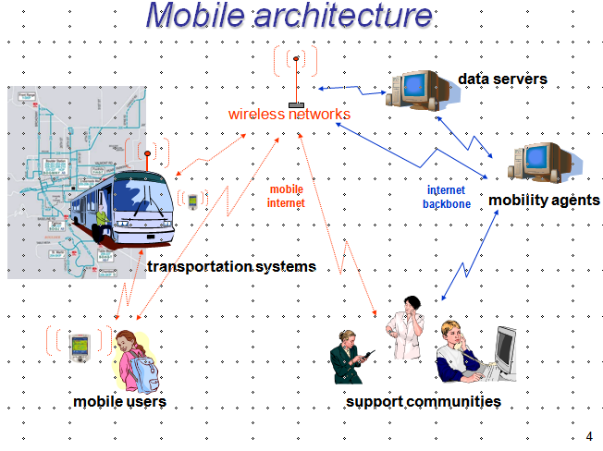
Projects
‘Going small: Mobility-for-all’
‘Mobility-for-all’

Slide 41
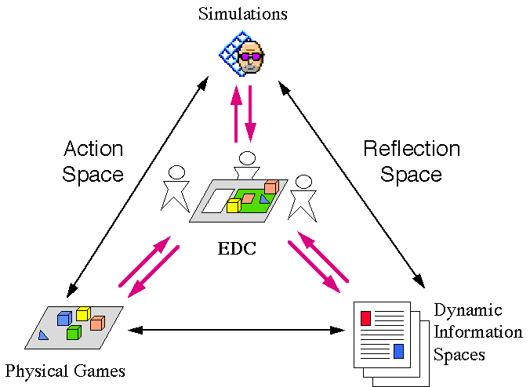
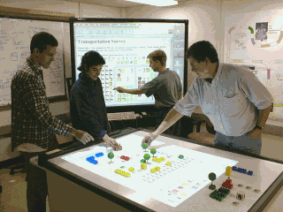
‘Going Large: Environment and Discovery Collaboratory’
Reflection Space
Action Space

Slide 42
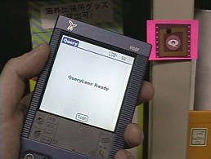
‘Going Everywhere: QueryLens’
‘QueryLens allows users to share and obtain useful information using mobile handheld devices. Users can simply look at a physical object through a “digital lens” in order to retrieve (and attach) queries (and information) that are relevant to the object.’

Slide 43
Lifelong learning
Enhance abilities to learn
Engage in meaningful activities
Exploit the power of media
Differs from school-based learning
self-directed, informal, tool-rich, collaborative
WMT support these dimensions (Sharples, 2000)

Slide 44
Distributed intelligence
Framework for understanding possible achievements of humans
How artefacts , tools and socio-technical environments can empower humans
‘Marry raw intellectual power of humans with appropriate technologies’

Slide 45
Discussion
How engaging did you find the article? Was it well-structured? How much impact will it have on education and learning? Were the projects mentioned worthwhile, and sufficiently well explained? Please describe your general reaction to the paper.

Slide 46
Positives
‘quite interesting and very thought provoking’
‘really important for the whole learning process’
‘applicable to modern style of education and learning’
‘glad they took the lifelong learning perspective’
‘main points that are in the paper are worth researching’
Negatives
‘rather technical in places’
‘Structure not particularly clear’
‘Concepts rather far-fetched’

Slide 47
To what extent do you agree with the authors when they say that mobile learning activities are too driven by technology or ‘add-ons to existing practices’ rather than genuine opportunities to transform educational experiences?

Slide 48
‘technology drives change and from this change new educational practices will emerge which take advantage of new technologies’
‘ a large number of these new technologies are designed from a perspective of seeing and treating humans primarily as consumers’
‘can be used to create powerful environments in which stating the possibilities of WMT, learners can access information in a context-aware perspective’

Slide 49
How do you think wireless and mobile technologies will impact on everyone’s lives in 2020? Or even further into the 21st Century?

Slide 50
Positives
‘Go anywhere, do anything technology will have come to pass as a result of universal access, improved broadband facilities and open access wireless nodes’
‘WMTE would change the goals of education’
‘Make classroom’s life much easier, enjoyable, fun and more productive’
‘It will change the ‘tech face’ of the earth significantly’
Negatives
Hacking, viruses, invasion of privacy and data protection issues will become even more paramount’
‘Apocalyptic style world a la Terminator’
‘Have to be careful and not to overuse the possibilities that WMTE offers’

Slide 51
Personal response
Innovative use of technology
Positive emphasis on learning rather than technology
Learner-centric
Inclusion seen as priority
Valuable and worthwhile field of research
Situated learning in authentic settings
Potentially big impact on future of mobile learning
‘Personally meaningful’
but…

Slide 52
Occasionally unclear and jargonistic
Some concepts may be unrealistic
Lack of data from projects means evaluating mobile learning difficult

Slide 53
Contribution to mobile learning design
Two design perspectives in a ‘tool-rich’ world:
‘Tools for living’ (distributed intelligence)
‘Tools for learning’ (‘scaffolding with fading’)

Slide 54
Contribution to mobile learning theory
Developing understanding of how WMT can:
Augment human intelligence
Personalise learning
Facilitate collaborative activities
Improve lives of people with cognitive difficulties
‘Change the context and goals of education’

Slide 55
Contribution to mobile learning practices
Opportunities:
Supporting intelligence augmentation
Social creativity
Informed participation
Unique needs of user
Pitfalls:
Destruction of notion of place
‘Gift-wrapping’ and ‘techno-determinism’
Violations of privacy
Understanding distinction between role of tools
Capturing context

Slide 56
Back to you, Robin....
Overall summary

Slide 57
Conclusions
Common themes:
All the articles discussed mobile technologies being applied to colllaborative learning of some type.
There was a strong theme of enhancing learner envolvement
There was a strong focus on communication

Slide 58
Conclusions
Implications for Mobile Learning theory:
Applications of mobile technology have been too technology driven
Need more focus on changing pedagogical theory to properly incorporate mobile technologies
Mobile technology seems to apply best to learner-driven methods
Mobile technology has particular strengths in:
Enhancing communication
Engaging the learner – it’s very inclusive
As a tool to augment normal human intellectual or physical behaviour, and therefore give more control to the learner

Slide 59
Conclusions
The future of mobile learning:
New ideas and practices emerging for the pedagogical sector
Learning theory is likely to evolve to better incorporate mobile technologies
Technology will inevitably drive change
More learner driven education practices
“Go anywhere, do anything technology”

Slide 60
Thanks!
Dr. Sharples, thank you for setting the assignment and setting up our discussion area.
To everyone in the three other groups, thank you for enthusiastically taking part in the discussions.
You can download this presentation from:
http://robinwinslow.co.uk/xxd582.html

Slide 61
References
M. Sharples [2007] Introduction to Special Issue of JCAL on mobile learning Journal of Computer Assisted Learning, 23, 4, 283-284.
Lai, CH., Yang, JC., Chen, FC., Ho, CW., & Chant, TW. [2007] Affordances of mobile technologies for experiential learning: the interplay of technology and pedagogical practices. Journal of Computer Assisted Learning, 23, 4, 326-337.
C.-C. Liu, L.-C. Kao [2007] Do handheld devices facilitate face-to-face collaboration? Handheld devices with large shared display groupware to facilitate group interactions. Journal of Computer Assisted Learning, 23, 4, 285-299.
G. Fischer, S. Konomi [2007] Innovative socio-technical environments in support of distributed intelligence and lifelong learning. Journal of Computer Assisted Learning, 23, 4, 338-350.
G1:1 Envisions Future Scenarios of Collaborative Learning with Technology
http://www.learningandteaching.info/learning/experience.htm
http://www.g1to1.org/resources/efsclt_2k5.php
http://l3d.cs.colorado.edu/systems/EDC/introduction.html
http://l3d.cs.colorado.edu/clever/projects/querylens.html

